Slide 1
Poll Aggregation
Natalie Jackson
Senior Polling Editor, The Huffington Post

Slide 2
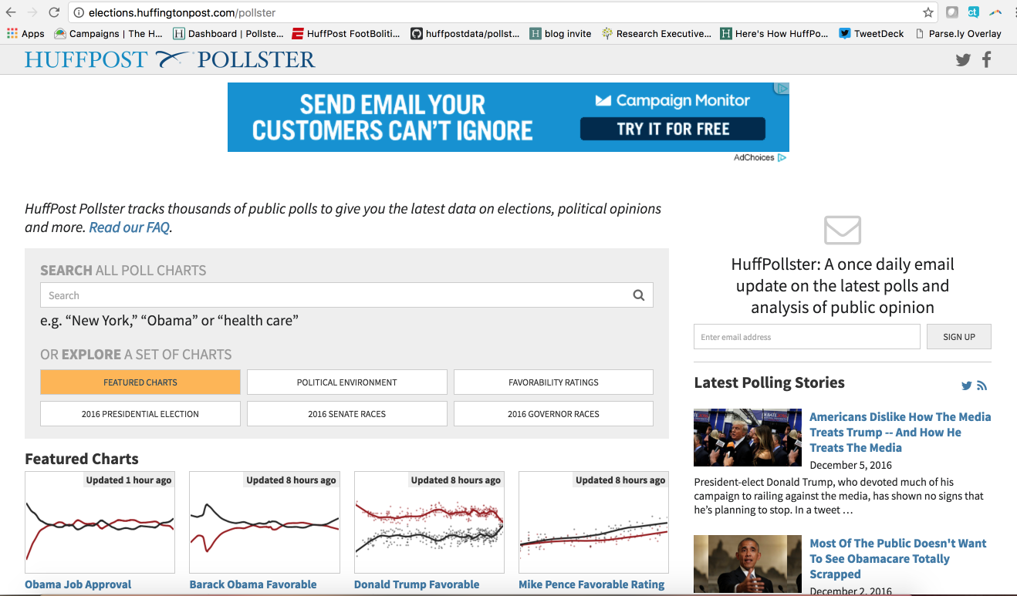
What huffpost pollster does
Collect all publicly released polls, vet them, enter data of accepted ones, create charts.
  Pollster used to take all publicly-released polls, but as polling has proliferated and data quality has wavered, we’ve become more selective.
Not just on elections – a variety of topics, including job approval and favorability of major political figures, opinion on major policy topics, the political environment

Slide 3
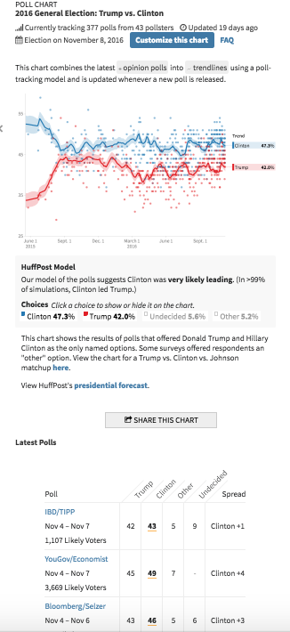
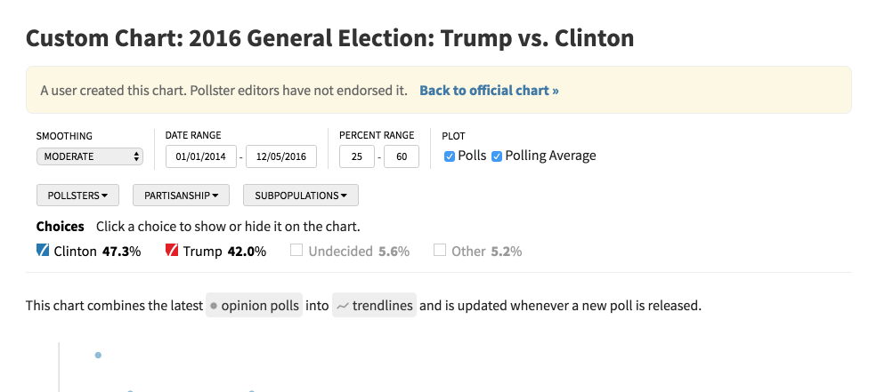
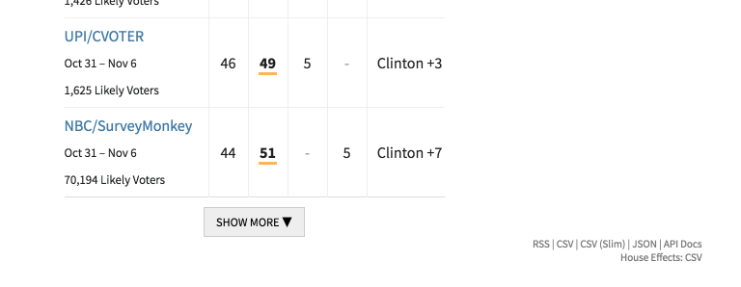
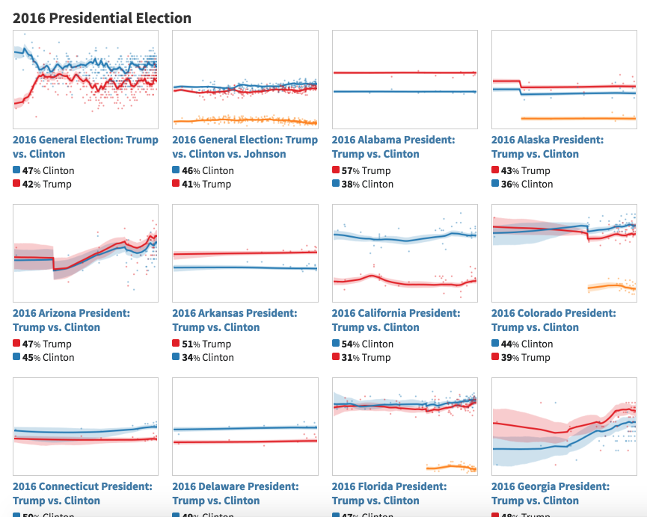
Site features

Slide 4
Which polls? Not all of them (but most)
HuffPost Pollster makes some basic transparency demands – this information must be made available to us (and preferably to the public)
  Sponsorship of the survey
  Fieldwork provider (if applicable)
  Dates of interviewing
  Sampling method employed
  Population that was sampled
  Size of the sample that serves as the primary basis of the survey report
  Size and description of any subsamples reported
  Margin of sampling error (if a probability sample)
  Survey mode
  Complete question wording and
  Percentage results of all questions reported

Slide 5
A few other “rules”
No DIY polls or polls that we can’t say approximate the population
  Polls conducted without active involvement by election pollsters or media organizations, or when not conducted or adjusted using methods that approximate the population or electorate.
  Telephone polls that do not make some effort to include cell phone only users — 48 percent of American adults
Question wording for election ballot tests
  Closed-ended trial heat poll questions, no extra information that will not be on the ballot, all relevant candidates listed
Tracking polls
  Overlapping field periods not included -- for example, if a poll reports a three-day rolling average every day, we only include every 3 days
Reporting on multiple populations
  We use the sample that most closely approximates the likely electorate — if they release registered voters and likely voters, we will use likely voters in the chart.
Notes:
Look up how many this excludes -- 126 TvsC polls out of TK total (percentage)

Slide 6
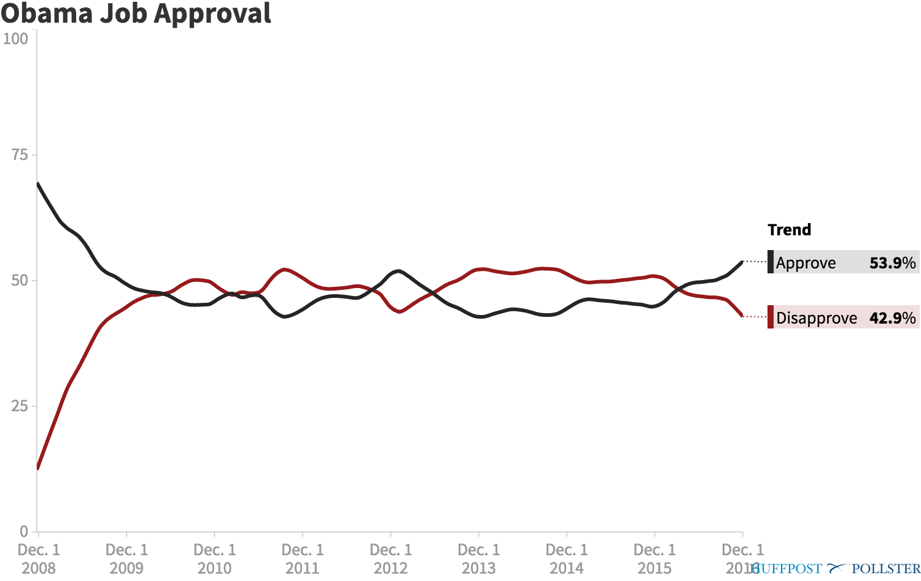
Advantages of aggregation

Slide 7
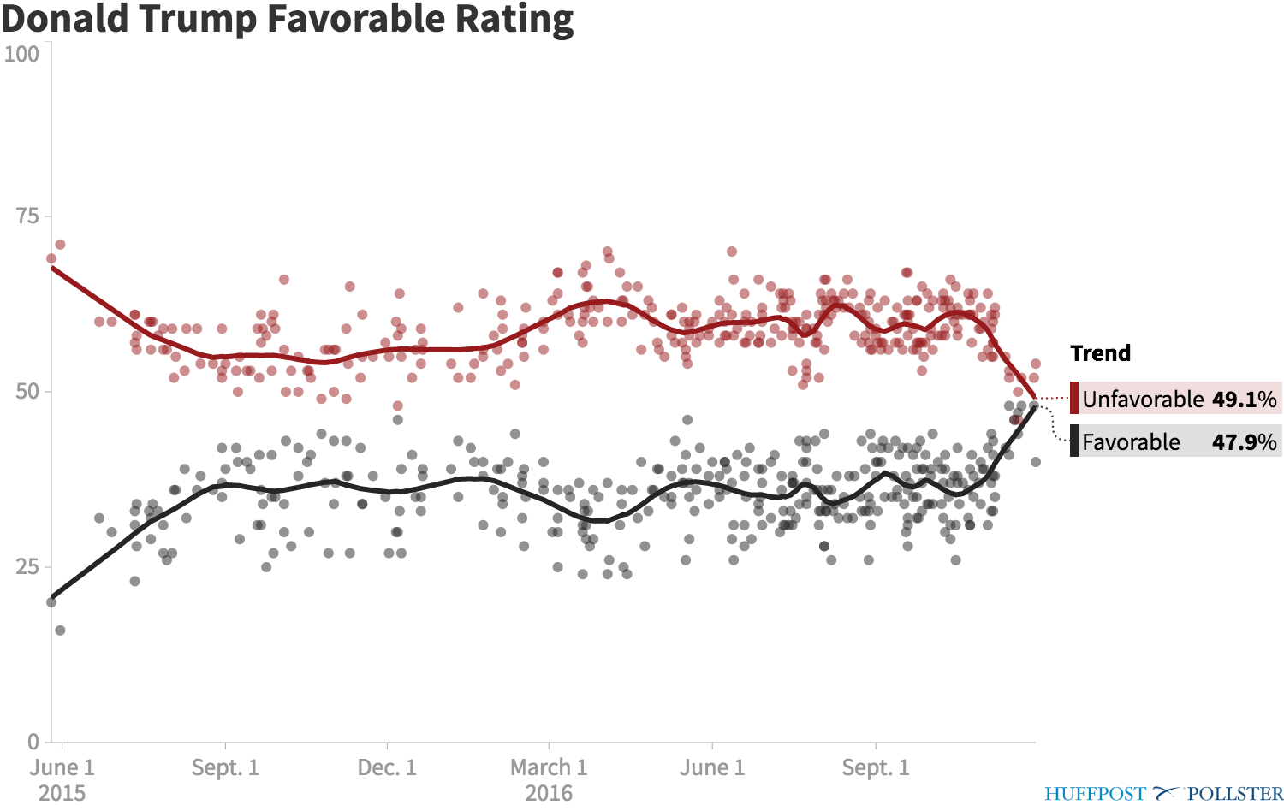
2 different modeling strategies: Loess regression

Slide 8
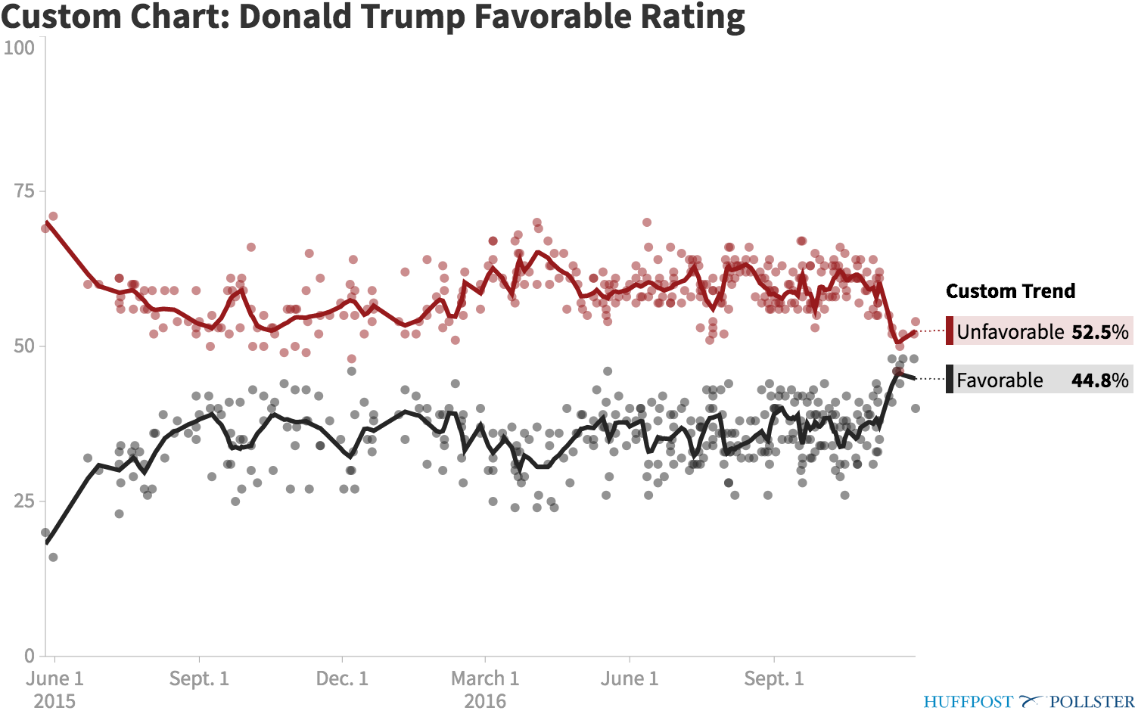
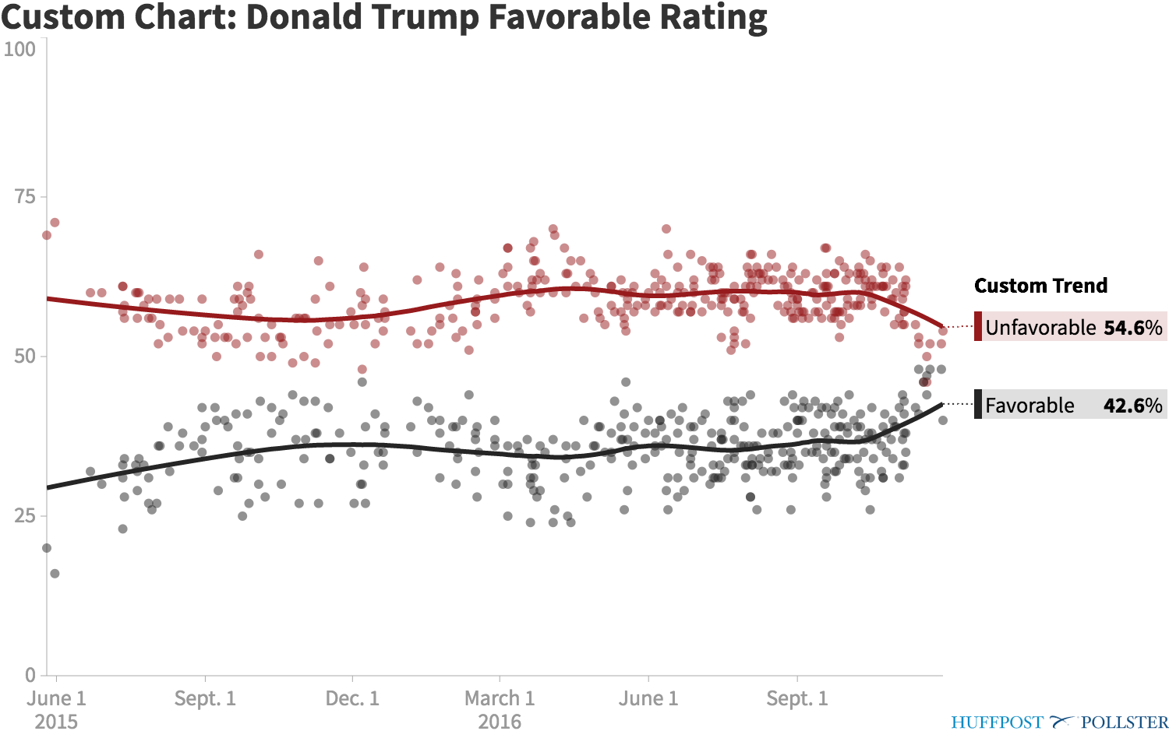
Loess regression: “sensitivity”

Slide 9
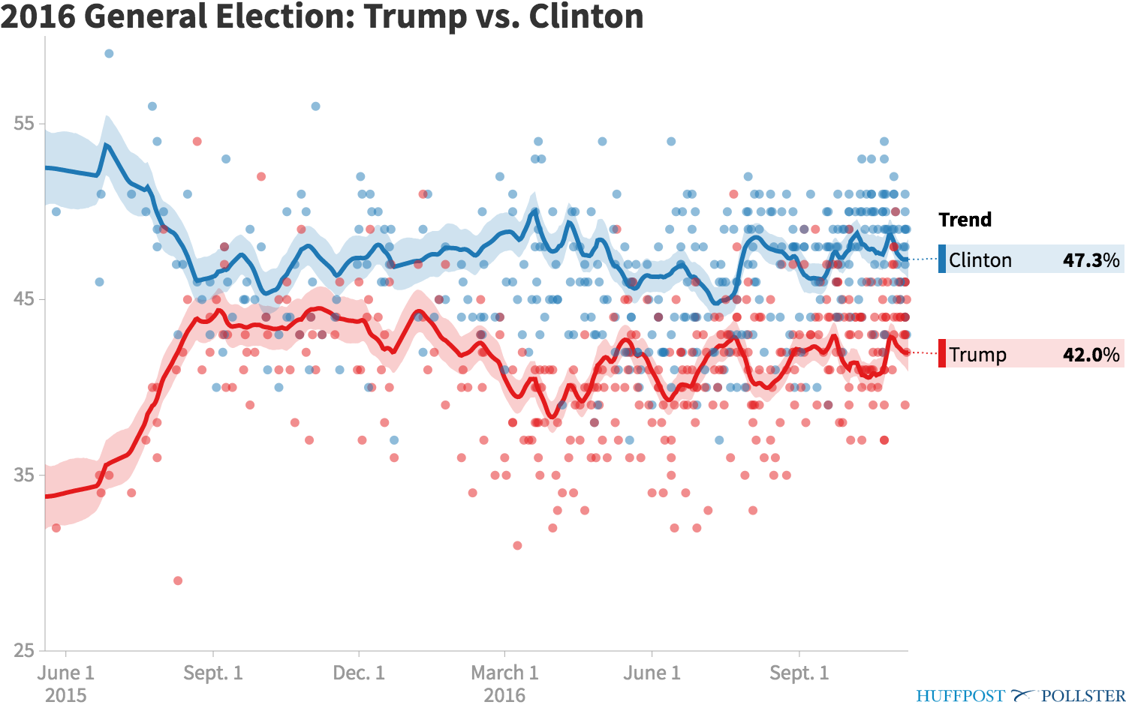
2 different modeling strategies: Kalman filtering

Slide 10
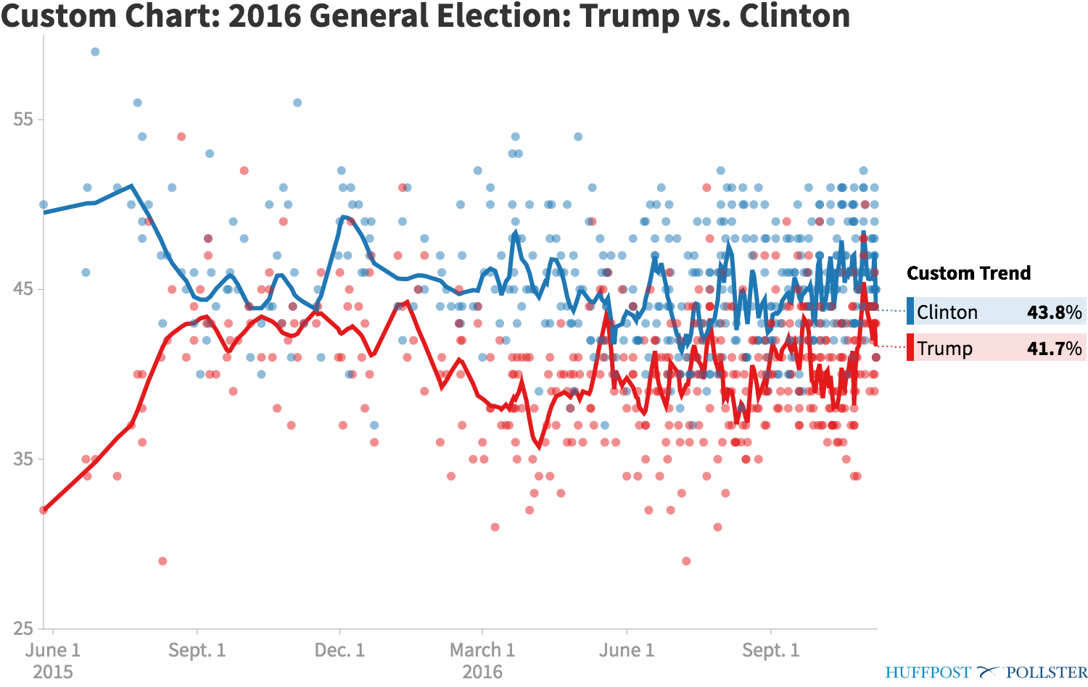
If we used LOESS Regression with little smoothing

Slide 11
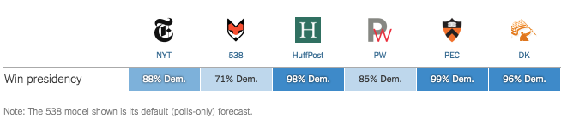
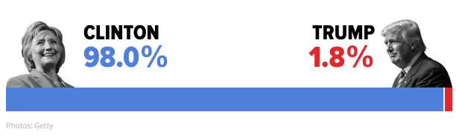
Using poll aggregations to forecast elections
Limitations of polls
  The Electoral College for U.S. presidential elections
  Undecideds in polls
  Varying data quality
  Implies more precision in the polls unless substantial adjustments made
We probably shouldn’t be used as sole predictors in this way – recognize the imprecision in the field instead of trying to push it

Slide 12
Aggregation is great, when used wisely
Provides a one-stop view of the state of the race, very useful for public who doesn’t have ability to know why poll results vary & a centralized database for researchers
Problems we face:
  Which polls to include – self-regulation (national polls often better than state polls)
  Clarifying the difference between an aggregate and a forecast
  Bad polls that turn out to be right
  Modeling strategies
  Communicating uncertainty of estimates (margins of error & other polling error)
Future of HuffPost Pollster:
  Improving and refining modeling strategies
  International expansion via HuffPost partners

