Slide 1

Transparency in Public opinion Research
Timothy Johnson
Survey Research Laboratory
University of Illinois at Chicago
Notes:
I would like to thank our hosts, and Rosario Aguilar in particular, for organizing this conference and for their wonderful hospitality. This is going to be a good several days.
Introduce self….

Slide 2
“Men whose research is based on shared paradigms are committed to the same rules and standards for scientific practice.”
  -Thomas S. Kuhn, The Structure of
  Scientific Revolution. 1962
Notes:
More than 50 years ago, the noted philosopher of science Thomas Kuhn had this to say about the importance of common rules and standards for the conduct of scientific research.
Kuhn also talked about scientific paradigms and shifts in paradigms during periods of scientific crisis.

Slide 3
Is public opinion research in a state of crisis?
Notes:
Do the methodological challenges currently facing public opinion research, including declining response rates in many countries and serious questions regarding the accuracy of polls, mean that we are now in a state of crisis?

Slide 4
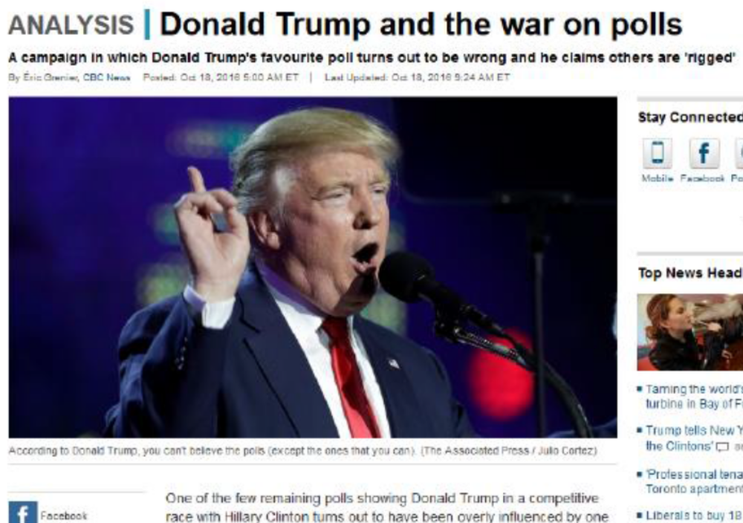
Is public opinion research in a state of crisis?
Notes:
Some would say “yes” As I am sure you are all aware, our soon-to-be-new President has publicly accused public opinion polls in the US of being biased and rigged. Such talk implies that perhaps the polls need to be more strongly regulated. But who would do the regulating, and how do we know that such regulation would make matters better instead of worse?
Of course, public opinion research is already regulated by governments in many countries.

Slide 5

WAPOR Freedom to Publish Opinion Poll Results: A Worldwide Update 2012
85 nations examined
Key findings
  Black-out periods for pre-election polls: 46%
  Any restrictions on conducting exit polls: 59%
  Any restrictions on publishing exit polls: 62%
  Any restrictions on topics covered by polls: 14%
Notes:
READ SLIDE
WAPOR is currently working on a 2017 update of this report

Slide 6
Some Rationales for Polling Restrictions
Polls trivialize elections by turning them into a horse race
Polls displace serious coverage of candidates & issues
Polls encourage negative media advertising campaigns
Polls encourage complacency among frontrunners and defeatism among trailing candidates
There is a conflict of interest when media conduct polls to generate news
Some politicians follow the polls rather than their convictions
Polls can be manipulated to influence and mislead

Slide 7
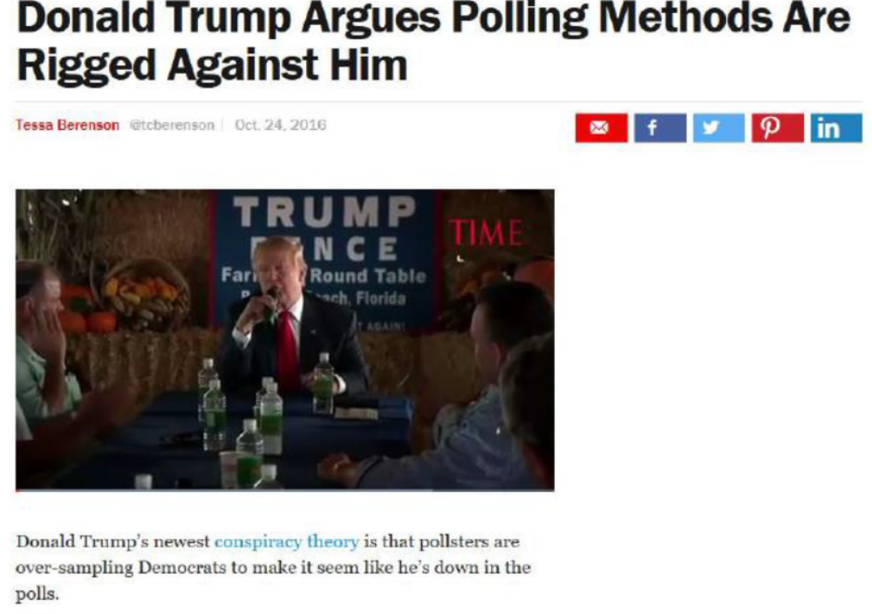

Slide 8
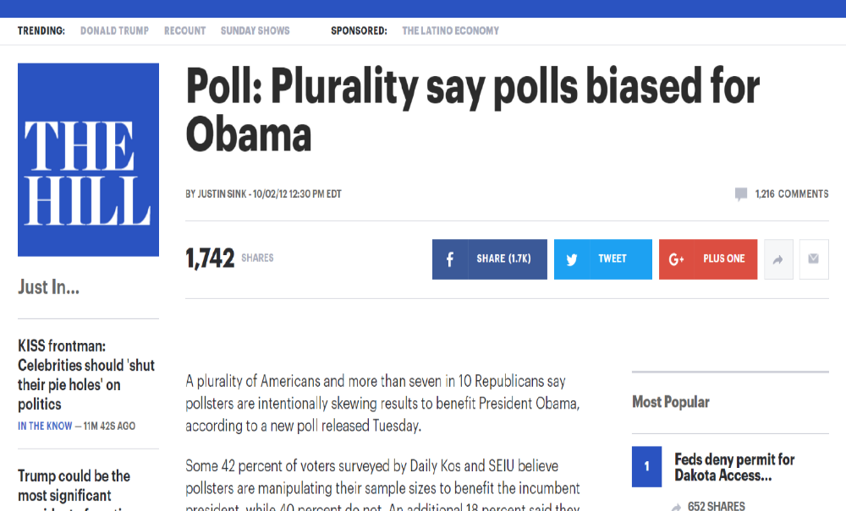

Slide 9
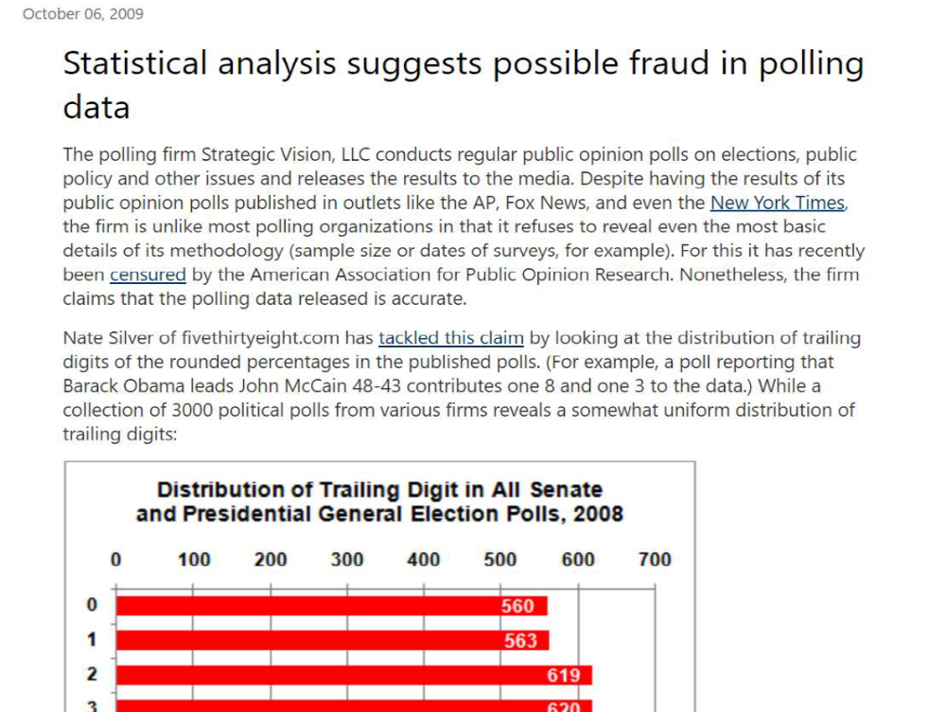
Notes:
But there are many serious examples of scientific misconduct involving polls and surveys where important evidence does exist.
Shortly after the 2008 US Presidential election, a polling firm was publicly censured by AAPOR for its refusal to reveal even the most basic details of its methodology, including sample sizes and survey dates. It’s not clear any of the 100+ polls this organization claimed to have conducted were actually real.

Slide 10
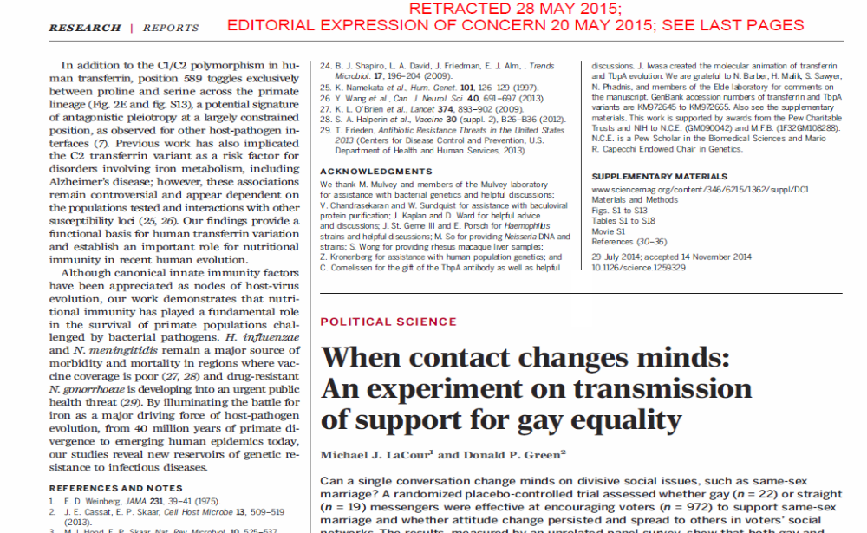
Notes:
This problem is not unique to public opinion polls. Academic social research that relies on survey data is not immune to concerns of biased or fabricated data. Less than two years ago, a study published by political scientists in one of our best journals had to be retracted due to concerns about how and whether the survey data was collected as reported. The crisis may be more widespread than many of us think.

Slide 11
Types of Regulation
Government regulation
  Covered by WAPOR report
Self regulation
  Voluntary adherence to professional standards
Notes:
There seem to be two general types of poll and survey regulation that might be considered. These include regulations imposed externally by governments, and voluntary adherence to standards of professional conduct. We considered earlier some of the reasons why government regulations might be the answer.

Slide 12
Types of Regulation
Government regulation
  Covered by WAPOR report
Self regulation
  Voluntary adherence to professional standards
“if national and international professional associations advance scientific and quality standards for conducting surveys and promote disclosure standards for survey methods, they will undermine the case for banning, censoring, or restricting polls.”
-Tom Smith (2004) International Journal of Public Opinion Research
Notes:
But what about voluntary self regulation? Former WAPOR President Tom Smith has written that “if national and international professional associations advance scientific and quality standards for conducting surveys and promote disclosure standards for survey methods, they will undermine the case for banning, censoring, or restricting polls.”

Slide 13
“Good professional practice imposes the obligation upon all public opinion and survey researchers to disclose sufficient information about how the research was conducted to allow for independent review and verification of research claims.”
  AAPOR Code of Professional Ethics and Practices (Revised 11/30/15)
Notes:
Relevant here is this statement from the AAPOR Code of Professional Ethics and Practices……
Replication, of course, is a critical feature of scientific inquiry.

Slide 14

Notes:
I’d like to turn our attention now to AAPOR’s attempt at self regulation known as the Transparency Initiative.

Slide 15

Why a Transparency Initiative? There is not enough transparency in the Social, Behavioral & Marketing Sciences.
Premise 1: Too often, there is inadequate transparency of research and statistical methods when the results of social and behavioral science research are disseminated.
Premise 2: This is a serious detriment to progress in these scientific domains.
Premise 3: Lack of transparency contributes to public disillusionment.
Notes:
We believe there is not enough transparency in social, behavioral and marketing research, particularly when results are being disseminated. This is a serious problem for research credibility as lack of transparency contributes to public disillusionment, and it makes it easier for those unhappy with research findings to challenge and discredit them.

Slide 16
Openness is fundamental to scientific inquiry and credibility.
AAPOR’s Transparency Initiative (TI) is designed to encourage openness in survey research so the field can advance.
TI is envisioned to enhance the credibility of our profession by encouraging disclosure of methodological information and educating the public on how to use it.
Notes:
We believe that openness is fundamental to scientific inquiry and to its credibility.
The Transparency Initiative is designed to encourage openness in survey research so the field can advance. It does so by emphasizing disclosure of methodological information and educating the public on how to use it.

Slide 17
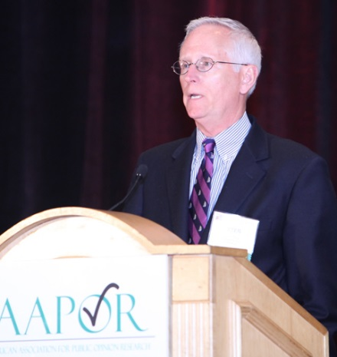
History of the Transparency Initiative
2010 AAPOR Conference: AAPOR President Peter Miller announces TI.
2010-11: Steering Committees worked to conceptualize and organize TI. First pilot test.
2011: WAPOR endorsement of TI.
2012-13: Multi-year TI Coordinating Committee appointed and charged with conducting second Pilot Test.
2013: Second Pilot Test conducted.
2014: TI officially launched; AAPOR journals adopt TI standards.
2015: US Federal Committee on Statistical Methodology acknowledgement of TI.
2016: total of 80 members accepted as of 12/1/16.

Slide 18
Transparency Initiative Members
ABC News
Abt-SRBI
American Association for Retired Persons
American Institutes for Research
American Legacy Foundation
Buendía y Laredo S.C.
California Health Interview Survey
California State Fullerton
Castleton Polling Institute
Center for Effective Philanthropy
Chicago Council on Global Affairs
Cornell University
D3 Systems
Decision Information Resources, Inc.
EdChoice
Elon University Poll
Emerson College Polling Society
Fairleigh Dickinson University
Gallup Organization
Gomez Research, Inc.
Goucher College
High Point University
Huffington Post
ICF International
iMediaEthics
Indiana University Center
InterMedia Survey Institute
Ipsos Public Affairs U.S.
JD Granz Research, Inc.
Kaiser Family Foundation
Langer Research Associates
Latin American Public Opinion Project at Vanderbilt University
Loyola Marymount University
Marist Poll
Marquette University
Mathematica Policy Institute
Michigan State University
Monmouth University
Muhlenberg College

Slide 19
Transparency Initiative Members, continued
National Research Center, Inc.
NORC at the University of Chicago
Pew Research Center
PolicyInteractive
Public Agenda
Public Policy Institute of California
Public Religion Research Institute
Quinnipiac University
Research Services at the Presbyterian Church
Roanoke College
RTI International
Rutgers University Eagleton Center
Sacramento State University
Siena College
SoonerPoll
Southern Illinois University
SSRS
Temple University
University of Arkansas at Little Rock
University of Chicago
University of Florida
University of Illinois at Chicago
University of Illinois at Springfield
University of Kentucky
University of Massachusetts Boston
University of Michigan Ctr for Political Studies
University of Nebraska
University of New Hampshire
University of North Florida
University of Northern Iowa
University of Pittsburgh
University of South Carolina
University of Virginia
University of West Georgia
University of Wisconsin
Urban Institute
Vanderbilt University
Washington Post
Westat
Western New England Univ
Winthrop University

Slide 20
TI Members by Sector
(as of December 1, 2016)
 | N | %
Academic | 44 | 55.0
Not-for-profit | 18 | 22.5
For-profit | 15 | 18.8
Media | 3 | 3.8
Government | 0 | 0.0

Slide 21
Revised AAPOR Code
Disclosure Items for Surveys
Report Immediately
Who sponsored & conducted
Exact question wording
Definition of population & geographic location
Dates of data collection
Sample frame description & any non-coverage
Name of sample supplier
[if panel]: recruitment methods
Detailed sample design
Method(s)/mode(s)/language(s)
[if probability]: sample size & error & any design effects adjustments
[if non-prob]: sample size & precision ONLY if detailed description of underlying model
Weighting & sources of parameters
Who contact for more information
Within 30 Days of request
Panel management procedures
Interviewer training, supervision & monitoring
Screening procedures
Relevant stimuli (show cards)
Strategies used to gain cooperation
Data quality procedures
Sample dispositions
[if reported]: AAPOR response and cooperation rates
Unweighted sample sizes for subgroup estimates
Specifications for replication of indices or statistical models

Slide 22
Revised AAPOR Code
Disclosure Items for Qualitative Research*
Include in any report or make available upon report release
Who sponsored & conducted research
Definition of population & geographic location
Instrumentation used & languages
Description of relevant stimuli (eg visual/sensory exhibits/show cards)
Dates of data collection & physical location
Subject eligibility
Number of research subjects, by data collection strategy
Methods of interviewer/coder training, supervision and monitoring
Duration of research participation
Any compensation or incentives provided to research subjects
Whether or not data collection included audio or video recordings used
*includes “focus groups, in-depth interviews, case studies, narrative research, and ethnography”

Slide 23
Revised AAPOR Code
Disclosure Items for Content Analyses*
Include in any report or make available upon report release
Who sponsored & conducted research
How content was collected or obtained
  Dates analyzed, languages, inclusion decision rules
Discussion of threats to validity/quality & steps to address
How analysis was conducted
  Coding process & coding schemes used
Inter-coder reliability & number of coders
Unit of analysis
[if relevant]: weight calculations & variables used
Other relevant information if surveys or qualitative data used
*Defined as the “systematic analysis of text, images or other content”

Slide 24

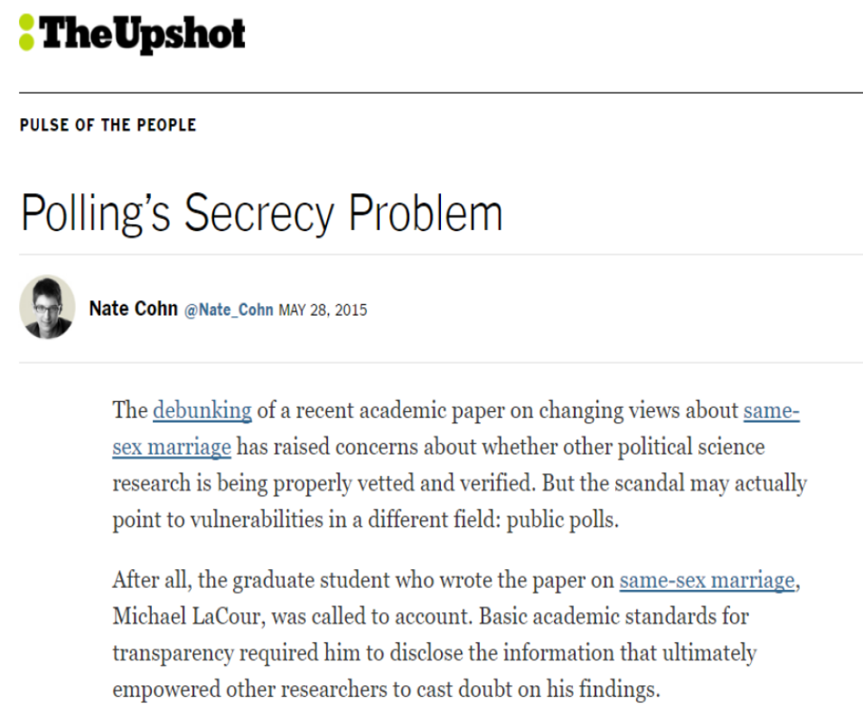

Slide 25
Revised AAPOR Code
Section III.E
Reflecting the fundamental goals of transparency and replicability, AAPOR members share the expectation that access to datasets and related documentation will be provided to allow for independent review and verification of research claims upon request. Datasets may be held without release for a period of up to one year after findings are publicly released to allow full opportunity for primary analysis. In order to protect the privacy of individual respondents, such datasets must be de-identified to remove variables that can reasonably be expected to identify a respondent. Those who commission publicly disseminated research have an obligation to disclose the rationale for why eventual public release or access to the datasets is not possible, if that is the case.

Slide 26
Future Plans
Develop new professional and public educational programs centering on transparency
Identify new strategies to encourage “spirit” of transparency
Long term goals:
  Collaborate with other professional associations to advocate for transparency of research methods
  Bring sunlight to non-traditional research methodologies
  Increase:
    Public knowledge and awareness of research transparency
    Public demand for research transparency
David Lambert

Slide 27
2015-2016 Transparency Initiative Coordinating Committee
James Dayton
  ICF International
Tim Johnson
  University of Illinois at Chicago
Scott Keeter
  Pew Research Center
Ashley Kirzinger*
  Kaiser Family Foundation
Ronald Langley
  University of Kentucky
Mary Losch
  University of Northern Iowa
Peter Miller
  Census Bureau
Tom Miller
  National Research Center, Inc.
Rich Morin
  Pew Research Center
Andy Peytchev
  University of Michigan
Dianne Ruchinski
  OS/OASH
Mandy Sha
  Research Triangle Institute
Trevor Tompson
  Associated Press-NORC Center for Public Affairs Research
Tim Triplett*
  Urban Institute
David Lambert
*Committee Co-Chair

Slide 28
Questions?
timj@uic.edu

Slide 29
